Slide 1
Microsoft Azure Training Day: Modernizing your application with containers and Serverless
Irina Kostina, Cloud Solution Architect ISV
https://linkedin.com/in/irina-kostina
Irina.Kostina@Microsoft.com

Slide 2
Goals for this session.
Review Container Service Options + Demo
Secure Secret Storage + Demo
Functions + Demo
Notes:
Today we will talk about container offerings that we have on Azure and why you might want to use one over other.
I will also be showing small demos here and there

Slide 3
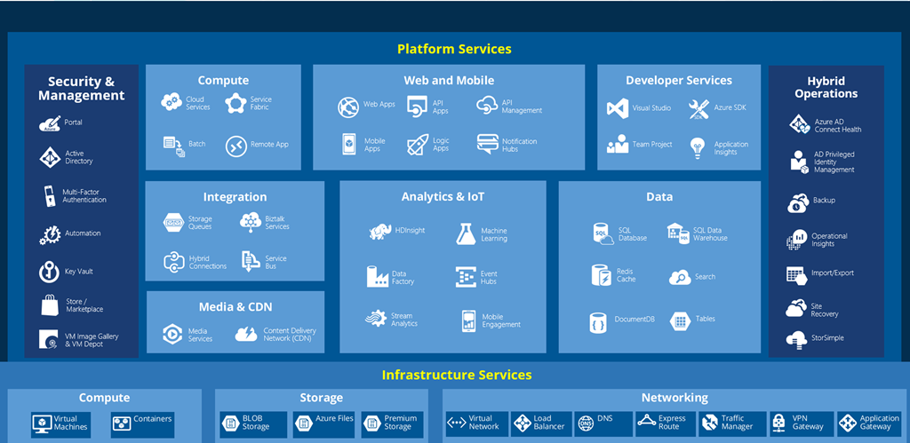
But where do you start?
Notes:
When you first open Azure you usually see something like this and especially around containers.
Everyone is talking about containers these days and they feel like the right thing to do, so we will talk about that as well.
But there is a lot of offerings so choosing which option is better can be difficult sometimes.
It’s impressive that we offer everything that you need or may need to fully embrace the Cloud.
But WHERE DO YOU START?

Slide 4
Containers
What they are and why they matter
What problem are we trying to solve?
What’s wrong with VMs?
Notes:
Today we will talk about container offerings that we have on Azure and why you might want to use one over other.
I will also be showing small demos here and there

Slide 5
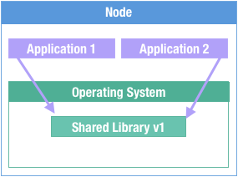
Why Containers?
Traditional Deployment
Notes:
So if you think about traditional application deployments , we provision it on VM with all dependencies to run our applications. And they probably depend on couple of shared libraries, hopefully the same shared library.
Othersiwe…

Slide 6
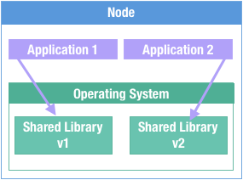
”Shared dependency” problem
Traditional Deployment
Notes:
We end up with this condition. Not something which didn’t happen to anyone before, right?
We end up with two applications and they both need different versions of some dependency.
Well, how do we handle that?
This is a very hard problem to solve. Maybe we update our application 1 to use version 2 of dependency, but what if we have to rollback, what if it comes up that there is another application which needs old version, and our machines just build up cruft over time.

Slide 7
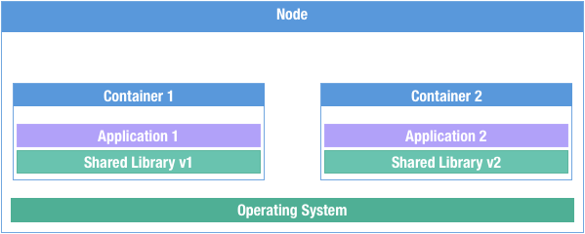
”Shared dependency” problem
Packaging and Deployment
Notes:
So the first problem which containers save is packaging and deployment problem.
So we can take our application bundled with our dependencies, and we can more it around with these dependencies. Which sounds promising, we have two different applications having their own versions of library, we also save the cruft problem, and we can also solve the “Works on my computer problem” since we guarantee that all dependencies are the same.

Slide 8
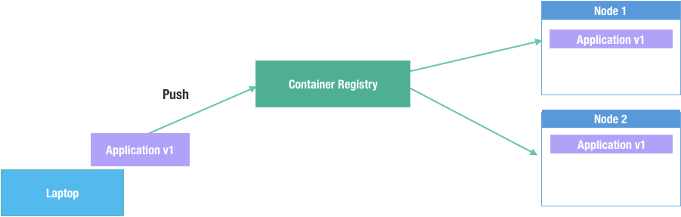
Distribution problem
Deployment and Distribution
Notes:
The second problem which is being solved is a distribution problem, how do we get our applications on those machines?
When we take our image that’s packaged up with our dependencies, we can push it up to a container registry, and it is able to be pulled from that registry.
The orchestrators or whatever you are using only need to know how to authenticate with the registry, they don’t need to know anything about your application or configurations that need to take place or dependencies which has to be installed on host node.

Slide 9
How do they work?

Slide 10
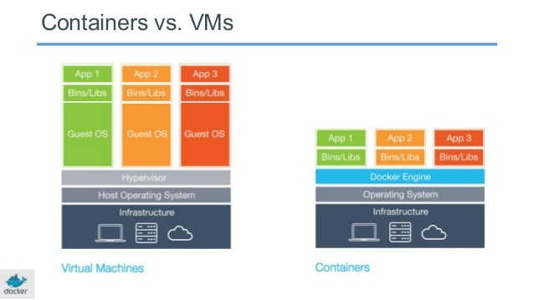
A Little Bit Like a VM, But...
Open format (OCI) & API
Shared OS Kernel
Different security model
Smaller, Faster
Notes:
In the beginning when they came out people often say that it is like ‘a lightweight VM’, but this is inaccurate, containers are more like highly configured processes.
But in case of Windows containers they are actually VMs, they are some kind of slim down Hyper-V, which provides kernel-level isolation
The container format is an open standard – called OCI – not constrained to a single vendor
Less overhead, higher performance, because they share many resources with the host rather than duplicate them like a VM
But fewer isolation guarantees
Containers use “namespaces” and “cgroups” to provide isolated resources to the contained application
Shared OS kernel is the key differentiator

Slide 11
How do containers work?
Highly configured processes.
They leverage kernel features:
Cgroups control the resources it can consume (cpu, memory, blkio, devices, net_prio, etc)
Namespaces control what the process can see (net, mnt, pid, user, ipc, etc)
Orchestrator pulls image and executes it
Notes:
but for linux containers is it basically what has been there in linux kernel for more than a decade.
It is baed of two Kernel constructs, one is called
cgroups (controls which resources an application can consume – how much CPU, how much memory, network)
Name spaces are what application can see, not just directory structures and things like this, can it see other processes in the system? What network interfaces is it able to see?
That is what always created an illusion that you are in a VM when you exec into a container is because your process gets put into the same namespaces as that application, and you see what is sees which is only itself.
So the container becomes container when orchestrator pulls image (we can think about is just basically a zipped file that bundles up all of the dependencies which is in your root directory and some metadata)
it extracts it into a directory, it executes the application, and then walls it off, meaning makes it so that it can only see what’s i that directory., makes it so that it can see only it’s own process, network interface and so on.

Slide 12
Security considerations
Containers share a kernel with the host OS
While containers offer a degree of isolation, they are not a hard security boundary
Kernel exploits and misconfigurations can allow an attacker to break out of the container
SELinux, AppArmor, Seccomp profiles can help to minimize the attack surface. (Linux)
Windows Hyper-V containers are highly tuned VMs and do provide VM level isolation
Notes:
So containers do not virtualize the underlaying hardware except for Windows, they do offer degree of isolation but they are not a hard security boundary.
On linux if I am running a container and I find a kernel vulnerability, I can use that to escape the container. So it is important to follow security procedures for container configuration
as well as use operating-system controls like AppArmor, Seccomp and SELinux, obviously not running containers as root, there is a lot of things to make it nearly impossible to escape the container.
But it takes understanding of those security controls and putting them together in place to do that.
On the linux side there are options for doing virtualized containers, things like Kata containers, which uses KVM to run your application inside of a container. Azure offering are virtualized containers,
So even if you are running a linux container , it is running in its own virtual machine, so you do have that hard virtualization security boundary.

Slide 13
Windows containers
Windows - contains the full set of Windows APIs and system services (minus server roles).
Windows Server Core - a smaller image that contains a subset of the Windows Server APIs–namely the full .NET framework. It also includes most server roles (~9GB)
Nano Server - the smallest Windows Server image, with support for the .NET Core APIs and some server roles (~600MB)
Windows 10 IoT Core – for hardware manufacturers for IoT devices that run ARM or x86/x64 processors
Notes:
Provide kernel isolation, so can be good for certain scenarios which require that
Good for .NET legacy applications

Slide 14
Wrap up - What are Containers?
Clear boundaries for your applications, allowing you to know which assets belong to which application and who owns it.
No more leftover cruft from previous installations or versions.
Provides resource isolation, without the overhead of more VMs.
Better resource utilization.
Notes:
If you peel away all the hype behind containers all that’s left is the simple truth:
-So they create clear boundaries for your applications, so we know which dependencies belong to which applications,
-we remove cruft from our virtual machines which builds up over time,
-we get better resource isolation without the overhead of having virtual machines
-we also get better resource utilization (30% is the typical CPU usage of the VM , and we can get up closer to 70-80% using things like orchestrators. ),
and we can pack our applications much more densely.
-Containers allow for repeatable deployments, regardless of the host environment.

Slide 15
Demo
Building docker image
Notes:
Ok, let’s take a look at docker file and see how to build a docker image.
I will be using a simple example for ACI , it is a node.js application
The from is the base image, it is zip file which exist already on docker hub, official empty image based on alpine linux with node js inside,
I’ve put here disabled commands for port to show how it can be done, in case you want to expose the port in container.
ENV is setting up environment variable, it can be very helpful to pass configuration into container.
Then we execute these things inside the container like making directory, copying files from our local environment into the app (working directory) and installing node.
And then CMD is basically what container runtime has to execute, in this case node.js running index file.
Another interesting thing is that each of these lines produced the layer and a copy on write file system. So we are able to cache all of these things.
If I add one more operation let’s say here, none of the previous steps have to be ran again, when I do a docker build. And also only the changes are being pushed and pulled to the docker registry.
It is important to think about this for two reasons:
If some part of your docker files is going to change regularly, you should put it further down in the docker file so that less work that has to be done with regards pushing to registry and rebuilding.
When I say that it creates a layer in image is that if you are creating artifacts that are going to be removed, say their build time dependencies, so you install a bunch of staff to do the build of your application, and then you delete in using another line in the docker file, That it NOT going to produce a smaller image size. And that is because that layer is saved, and those layers are getting transferred to and from the registry. If you add all that to one line, the result is what get commits as a layer.
I hope it makes sense.
Anyway so here we have a docker file, now we just need to build an image out of this and run it.

Slide 16
What else are they good for?

Slide 17
Multi-Stage Builds
FROM golang:alpine as builder
RUN apk add --no-cache \
ca-certificates
RUN go build
FROM scratch
COPY --from=builder /usr/bin/hello-golang /usr/bin/hello-golang
COPY --from=builder /etc/ssl/certs/ /etc/ssl/certs
ENTRYPOINT [ "hello-golang" ]
Notes:
We can also do these multi stage builds.
Again we are using the alpine linux image as the builder, and then we are running a couple of commands including the go build. I hope there is no go-programmers here, otherwise I am in trouble.
So we build our go application and it is in one image.
But down here we have a start of the second image, so scratch is a linux container which basically has nothing in it. It is not a linux distro, and we use this if we only have our self-contained binary that has no dependencies.
So we are creating a second image and we are copying over the artifacts which were produced in the first image.
Multi stage builds let you set up – or stage – some resources, and then build a "final" image that has resources from the staged container
The final image only has what you decided to copy from previous stages
It is able to produce the artifacts and we don’t have to worry about all the build time dependencies being inside our runtime container.
So this makes
-smaller images
-makes things more secure because there is less attack surface in the run-time container.

Slide 18
Azure Container Options
Notes:
Alright, so we have our container, how do we get it into the cloud?
Azure has multiple options for this,

Slide 19
I built a container… What do I need?
Build
-Handle and update dependencies including the OS
Deploy
-Run containers across multiple machines
-Configuration as code
Operate
-Monitor
-Scale up/down
Notes:
So, the thing is , I got a container, so what do I do next?
There are 3 things you have do:
You need to build a container image, take care of the OS patching and dependencies
Then you need to deploy, where you come across questions like
handling environments – how do I configure my dev / prod envs ?
Then you need to Operate:
You need to make sure that you have monitoring for your containers to understand if you need more capacity.
In case if something goes wrong then you need to make sure that you have setup diagnostic logs.
And of course you need to make sure that you scale on demand.
All of these and more is called container orchestration.

Slide 20

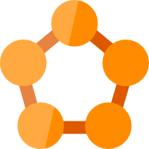

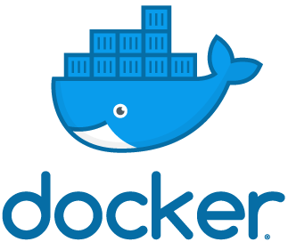




Containers in Azure
App Service
Service Fabric
Kubernetes Service
Container Instance
Ecosystem
Deploy web apps or APIs using containers in a PaaS environment
Modernize .NET applications to microservices using Windows Server containers
Scale and orchestrate Linux containers using Kubernetes
Elastically burst from your Azure Kubernetes Service (AKS) cluster
Bring your Partner solutions that run great on Azure
Azure Container Registry
Docker Hub
Choice of developer tools and clients
Notes:
Azure provides you with variety of options
Depending on what your scenario is.
You can host a container on AppService (which was called Azure websites back in days).
Just pull container images from Docker Hub or a private Azure Container Registry, and Web App for Containers will deploy the containerized app with your preferred dependencies. The platform automatically takes care of OS patching, capacity provisioning, and load balancing.
Service Fabric is an underlying technology for many Microsoft services, for example media services or cortana is running on SF. It is basically an orchestrator but it makes sense to use it when you have a native .NET application or a need for windows server containers
CI is similar to App service – allows you to run single container, but in a different manner.
Advantages:
-More density

Slide 21
Azure Container Registry & Azure Container Instances

Slide 22
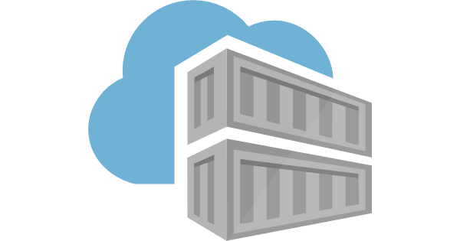
Azure Container Registry
Use same docker commands as Docker Hub
Private
Eliminates egress/ingress traffic and latency
Geo-replication - a single registry replicated across multiple regions
Authenticate with Azure Active Directory
Automatic Vulnerability Scanning (CVE)
Azure Container Registry Tasks / Builders

Slide 23
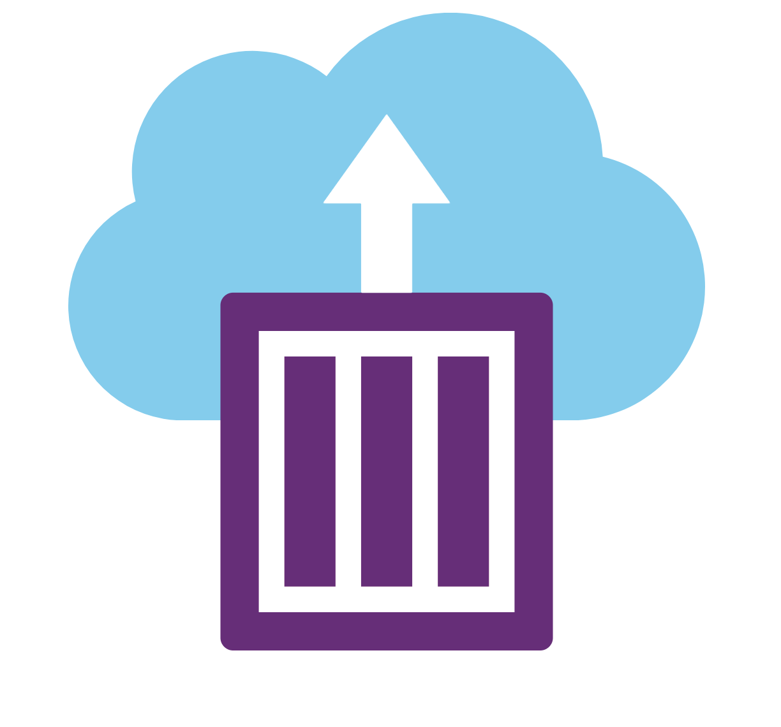
Azure Container Instances
Start in seconds
No VM management
Custom CPU/memory
Billed per second
Public IP
Hypervisor-level isolation
Linux and Windows containers
Batch processing
Lift and shift into containers
Simple web services
Compute intensive workloads
CI agents
$48/month for 512MB and 1 vCPU
Notes:
So ACI is container on demand , in fact is it container group, so you can execute more than one container, side by side.
You are billed per second, there is a lot of azure services integrations and you don’t need complex infrastructure and any Kubernetes cluster or virtual machines.
You can have it running in private network or expose it to public. .
You can mount persistent storage and we get support for both linux and windows containers.
Useful for short-lived processes, maybe batch work, or if you are doing machine learning models you can span this out really wide and pay only while it is running.
CI/CD workloads would be good for this.
But if you have long-running workloads it will be cheaper to use other options.
Azure Container Instances offers the fastest and simplest way to run a container in Azure, without having to provision any VM .
It provides some of the basic scheduling capabilities of orchestration platforms.
If you have long-running, stable workloads, orchestrating containers in a cluster with Kubernetes or SF is typically cheaper than running the same containers with Azure Container Instances. This is because the price of the ACI is 50$ in a month only for one container, if you get pre-paid instances of VMs on Azure you get it cheaper and you can put more Containers on these VMs.
However, container instances offer a great solution for quickly expanding and contracting your overall capacity to deal with unexpected or short-lived spikes in usage.
Rather than scaling out the number of virtual machines in your cluster, then deploying additional containers onto those machines, the orchestrator can simply schedule the additional containers in Azure Container Instances, and delete them when they're no longer needed.

Slide 24
ACI Permanent Limitations
No support for:
Zero-downtime upgrades
Maintain > 1 running replicas
Batch workflows
Service discovery
Integrated load balancing
Auto-scaling
If you need these features, you probably need an orchestrator

Slide 25
Azure Container Instances demo

Slide 26
But We’re Developers and Operations
Why do manually what you can automate?
Three Different Ways To Build Containers
docker build; docker push*
az acr build*
Azure Devops Pipeline
*manual

Slide 27
Secrets
Everybody has them

Slide 28
The Problem
We need database credentials in app
Insecure: hard-code secrets into Dockerfile
Insecure: hard-code secrets into scripts
How do we securely store and inject secrets?
Notes:
Our problem is that some of our containers need credentials to communicate with database which provides the data, but how do we get those credentials?
We could hardcode it in provisioning scripts or docker files, but that is ridicously insecure, and you really wouldn’t like to build new image each time credentials change.
Also think about different environments for production and test.
We also don’t want to store secrets inside source control.
So how do we securely store secrets to get them into containers?

Slide 29
Azure KeyVault
Secure storage for secret data
Everything stored in Hardware Security Modules (HSMs)
Integrated with many Azure Services
Store Keys, Secrets, Certificates
Strict control and auditing of Key Vault
Notes:
One option would be to use something like azure key vault, which is a secret management store, it even has things like hardware security modules if you work in environment where that is required.
You can store encryption keys, generic secrets that you have, as well as certificates, and you can use Azure Active Directory to mange who has permissions to which secrets to which secrets whether they can read to them or write to them or even specific things like you’re only allowed to commit Secrets to KeyVault (you a.re not allowed to commit certificates).
Secret data = passwords, certificates, API tokens, encryption keys, ...
Hardware Security Module, not High School Musical

Slide 30
Create a Keyvault
az keyvault create \
--resource-group $RES_GROUP \
--name $AKV_NAME
Notes:
Creating a keyvault is pretty straightforward, you just need to have a resource group created for it.
It is a single command on command line, you can also create it from azure portal.
Show different pricing tiers and network restrictions.

Slide 31
Store a Secret
az keyvault secret set \
--vault-name $AKV_NAME \
--name 'web3-mongo-connection’ \
--value $DB_CONNECTION_STRING
Notes:
Storing a secret is pretty straightworward as well, you give it a name and you give it a value , the same thing is also in the portal.
A nice thing is that we can actually track changes, in case if you need to go back or somebody has overwritten the code or certificate you never gonna loose that.

Slide 32
Read a Secret on the Command Line
az keyvault secret show \
--vault-name $AKV_NAME \
--name web3-mongo-connection \
--query value \
-o tsv
Notes:
Reading a secret is also pretty straightforward , in the portal there is also a button where you can see the secret.
-tsv is just a format for output (tab separated format)

Slide 33
Azure Functions
Serverless to next level
Notes:
Serverless I actually feel like is an overloaded term.
Most of us use this term to basically interchangeably with functions as a service and I think that function as a service is implementation of serverless but I think serverless really is when stop thinking about the virtual machines ,
We stop thinking about nodes , pods and all that stuff.

Slide 34
Azure Functions Overview
React to external triggers
Azure defines supported languages
"glue" services together
Small applications, simple deployments
Available in: C#, F#, Java, JS, Python(3), PowerShell
Notes:
Azure functions allow you to have small code snippets of code , you can also have big one if you really want to, that are able to react to external trigger. Things like an email coming in, file dropped on FTP, so record inserted into ComsosDB
And we can use them a lot to glue services together to crete this model where we don’t have some application constantly pulling to make sure if there is a commit on git or something like that.
Typically very small applications with simple deployments,

Slide 35
Timers
Built-in Azure functions trigger
Calls your code on an interval
Reports?
Replace existing ‘cron’ jobs
Nightly reports emailed to staff
Notes:
Even uses the same syntaxx as cron!
One thing which is interesting is TimeTrigger.
This allows to set an interval for our function to be called ans that sounds a lot like a cron job or a scheduled task.
Now that the application is deployed in Azure Web Apps they have another problem to solve.
A few of their users depend on nightly reports that were generated on their in-house servers
There must be a way to replicate this functionality in the cloud?

Slide 36
Demo Azure Functions
HttpTrigger function accessing Secret in KeyVault
Notes:
So here basically I have an HttpTrigger function meaning that it will be running only when someone calls the url.
It takes the parameter as order Id, the idea is that you can process asynchronously some orders, like store it in cosmos or stuff like that afterwards.
And here as well I have a method to get a secret from keyvalult. You basically just need a url of the key vault and them if you are logged into azure portal it will automatically identify the service principal of the function and provide access to it,.
Show in Functions Platform Features – Identity

Slide 37
Putting it All Together
Website Code ->Docker Image -> Azure Container Registry + ACI
“Cron job” -> Azure Functions

Slide 38
Thank you!
Irina Kostina, Cloud Solution Architect ISV
https://linkedin.com/in/irina-kostina
Irina.Kostina@Microsoft.com

Slide 39
